Slide 1

Introduction to IT Consulting Week 9 Service Model Slides Monday, April 14 2025
Gil Regev
EPFL – I&C gil.regev@epfl.ch

Slide 2
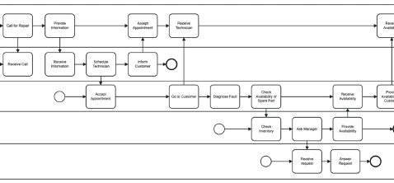
Service View
Appliance Market
FKE
Repair
Angelia.
Non-Functioning Appliance
Repair
Appliance
Functioning Appliance
Fridge Doesn’t Work
Get My Fridge
To Work
Fridge Works
FKE
Christiane
Bruno
Coordinate
Repair
Manage Repair
Repair
Mishel
François
Manage
Inventory
?
IT

